Slide 1
21CSC201J DATA STRUCTURES AND ALGORITHMS UNIT-4 Topic : Hashing Introduction

Slide 2
Hashing
In hashing, large keys are converted into small keys by using hash functions.
• The values are then stored in a data structure called hash table.
• The idea of hashing is to distribute entries (key/value pairs) uniformly across an array.
• Each element is assigned a key (converted key).
• By using that key you can access the element in O(1) time. Using the key, the algorithm (hash function) computes an index that suggests where an entry can be found or inserted.

Slide 3
Hashing
Hashing is implemented in two steps:
• An element is converted into an integer by using a hash function. This element can be used as an index to store the original element, which falls into the hash table.
• The element is stored in the hash table where it can be quickly retrieved using hashed key. • hash = hashfunc(key) index = hash % array_size.

Slide 4
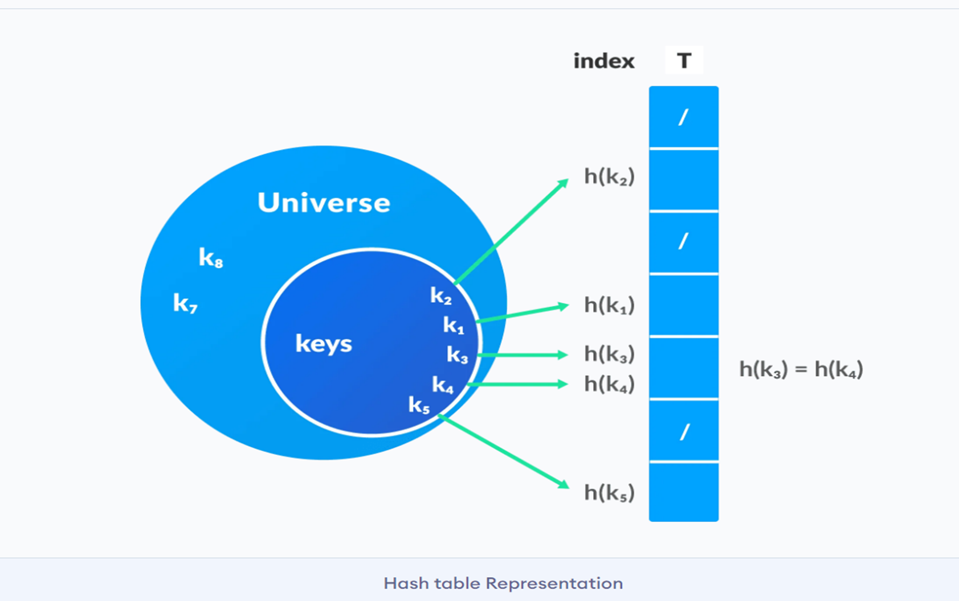
Hashing

Slide 5

Hash Table
The Hash table data structure stores elements in key-value pairs where
Key- unique integer that is used for indexing the values
Value - data that are associated with keys.

Slide 6
Hash Collision
When the hash function generates the same index for multiple keys, there will be a conflict (what value to be stored in that index). This is called a hash collision.
If x1 and x2 are two different keys, it is possible that h(x1) = h(x2). This is called a collision

Slide 7
Collision Avoidance
.
Collision resolution is the most important issue in hash table implementations.
Choosing a hash function that minimizes the number of collisions and also hashes uniformly is another critical issue.
Separate chaining (open hashing)
Linear probing (open addressing or closed hashing)
Quadratic Probing
Double hashing

Slide 8
Separate chaining (open hashing)
Unlike chaining, open addressing doesn't store multiple elements into the same slot. Here, each slot is either filled with a single key or left NIL.
Different techniques used in open addressing are:
i. Linear Probing
ii. Quadratic Probing
iii. Double hashing

Slide 9
Linear Probing
In linear probing, collision is resolved by checking the next slot.
h(k, i) = (h′(k) + i) mod m
where
i = {0, 1, ….}
h'(k) is a new hash function
If a collision occurs at h(k, 0), then h(k, 1) is checked.
In this way, the value of i is incremented linearly.
The problem with linear probing is that a cluster of adjacent slots is filled. When inserting a new element, the entire cluster must be traversed.
This adds to the time required to perform operations on the hash table.

Slide 10
Linear Probing
Let us consider a simple hash function as “key mod 7” and a sequence of keys as 50, 700, 76, 85, 92, 73, 101,
which means hash(key)= key% S,
here S=size of the table =7,indexed from 0 to 6.
We can define the hash function as per our choice if we want to create a hash table,although it is fixed internally with a pre-defined formula.

Slide 11
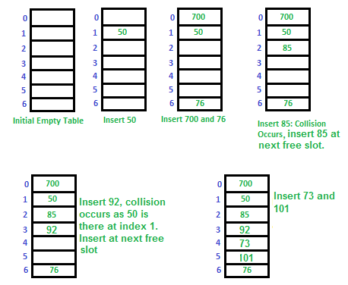
Linear Probing

Slide 12
Quadratic Probing
If you observe carefully, then you will understand that the interval between probes will increase proportionally to the hash value.
Quadratic probing is a method with the help of which we can solve the problem of clustering that was discussed above. This method is also known as the mid-square method.
In this method, we look for the i2‘th slot in the ith iteration. We always start from the original hash location. If only the location is occupied then we check the other slots

Slide 13
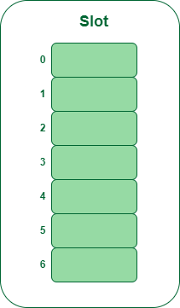
Quadratic Probing
Example: Let us consider table Size = 7, hash function as Hash(x) = x % 7 and collision resolution strategy to be f(i) = i2 . Insert = 22, 30, and 50.
Step 1: Create a table of size 7.

Slide 14
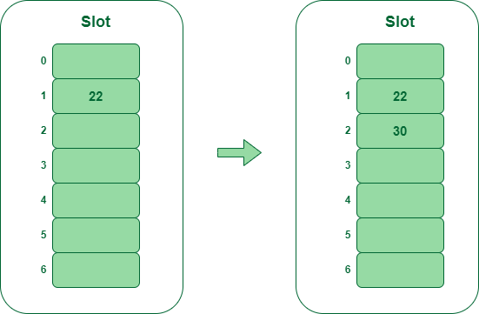
Quadratic Probing
Step 2 – Insert 22 and 30
Hash(22) = 22 % 7 = 1, Since the cell at index 1 is empty, we can easily insert 22 at slot 1.
Hash(30) = 30 % 7 = 2, Since the cell at index 2 is empty, we can easily insert 30 at slot 2.

Slide 15
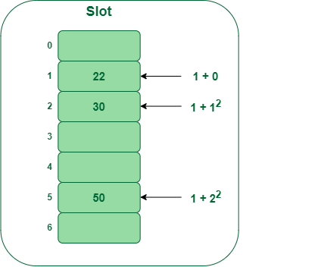
Quadratic Probing
Step 3: Inserting 50
Hash(50) = 50 % 7 = 1
In our hash table slot 1 is already occupied. So, we will search for slot 1+12, i.e. 1+1 = 2,
Again slot 2 is found occupied, so we will search for cell 1+22, i.e.1+4 = 5,
Now, cell 5 is not occupied so we will place 50 in slot 5.

Slide 16
Double Hashing
The intervals that lie between probes are computed by another hash function. Double hashing is a technique that reduces clustering in an optimized way. In this technique, the increments for the probing sequence are computed by using another hash function. We use another hash function hash2(x) and look for the i*hash2(x) slot in the ith rotation.
let hash(x) be the slot index computed using hash function.
If slot hash(x) % S is full, then we try (hash(x) + 1*hash2(x)) % S
If (hash(x) + 1*hash2(x)) % S is also full, then we try (hash(x) + 2*hash2(x)) % S
If (hash(x) + 2*hash2(x)) % S is also full, then we try (hash(x) + 3*hash2(x)) % S

Slide 17
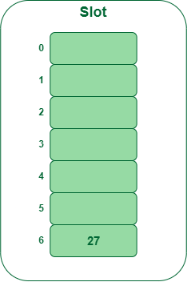
Double Hashing
Example: Insert the keys 27, 43, 692, 72 into the Hash Table of size 7. where first hash-function is h1​(k) = k mod 7 and second hash-function is h2(k) = 1 + (k mod 5)
Step 1: Insert 27
27 % 7 = 6, location 6 is empty so insert 27 into 6 slot.

Slide 18
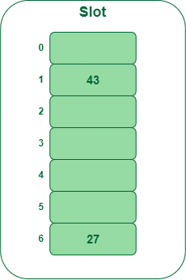
Double Hashing
Step 2: Insert 43
43 % 7 = 1, location 1 is empty so insert 43 into 1 slot.

Slide 19
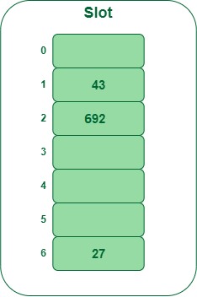
Double Hashing
Step 3: Insert 692
692 % 7 = 6, but location 6 is already being occupied and this is a collision
So we need to resolve this collision using double hashing.
hnew = [h1(692) + i * (h2(692)] % 7
= [6 + 1 * (1 + 692 % 5)] % 7
= 9% 7
= 2
Now, as 2 is an empty slot,
so we can insert 692 into 2nd slot

Slide 20
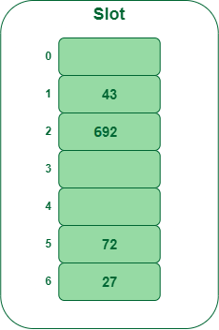
Double Hashing
Step 4: Insert 72
72 % 7 = 2, but location 2 is already being occupied and this is a collision.
So we need to resolve this collision using double hashing.
hnew = [h1(72) + i * (h2(72)] % 7
= [2 + 1 * (1 + 72 % 5)] % 7
= 5 % 7
= 5,
Now, as 5 is an empty slot,
so we can insert 72 into 5th slot.

Slide 21
Thank You

